Slide 1

Coffee Quality Data Analysis
By Lam Nageswara Rao

Slide 2
Background & Problem Statement:
About the Coffee Quality Institute (CQI) :
The Coffee Quality Institute (CQI) is a non-profit organization that works to improve the quality and value of coffee worldwide. It was founded in 1996 and has its headquarters in California, USA.
The organization collaborates with coffee growers, processors, roasters, and other stakeholders to improve coffee quality standards, promote sustainability, and support the development of the specialty coffee industry.
Business Need:
Identify key attributes contributing to coffee quality, analyze patterns based on region, processing, and altitude.

Slide 3


Technical Stacks:

Slide 4
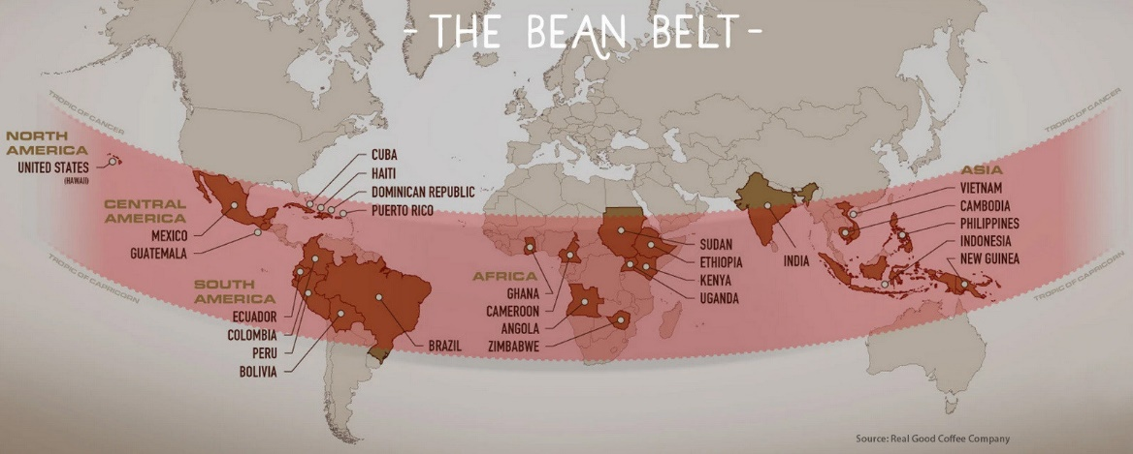

Slide 5
Dataset Overview:
Source: Coffee Quality Institute Dataset.
Key Features:
Country, Processing Method, Variety
Sensory Scores: Aroma, Flavor, Acidity, Aftertaste, etc.
Altitude, Moisture, Color, etc.
Target Variable: Total Cup Points

Slide 6
Data Cleaning & Feature Engineering
Removed missing/null values
Created Total Production = Bag Weight × No. of Bags
Calculated Altitude_Avg from range
Binned Altitude into categories: Low, Medium, High
Created Quality Tier: Poor, Average, Good, Excellent

Slide 7
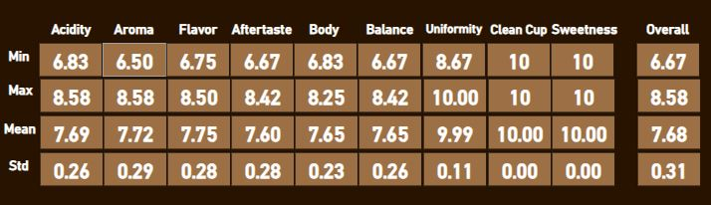
Descriptive Insights :
Countries with the most samples : Taiwan , Guatemala
Most common Processing Methods : Washed/Wet, Natural/Dry
Average scores of sensory variables :

Slide 8
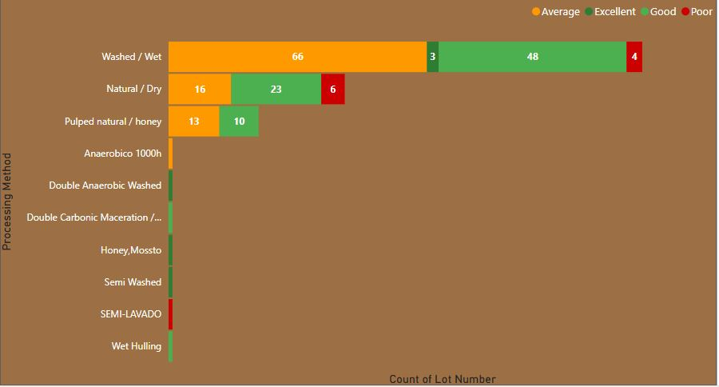
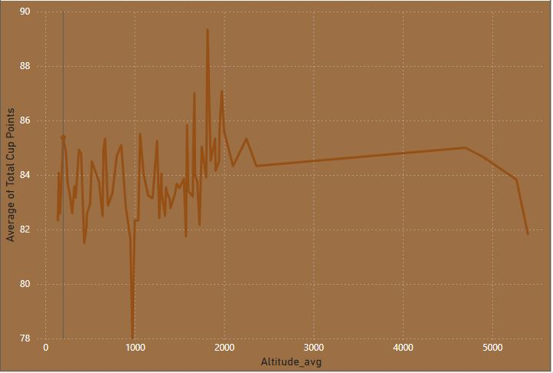
Deep-Dive Visual Insights :
Processing Method vs No. of Samples split by Quality Tier:
Altitude vs Cup Points :
🎯 Insight: Washed/Wet method has more “Average” & “Good” tier samples.
🎯 Insight: Medium to high altitude beans yield better cup points.

Slide 9
Business Recommendations:
Invest in regions and processing methods that produce “Excellent” quality.
Focus on varieties and altitudes producing higher cup points.
Encourage consistent sensory scoring standards.

Slide 10


